Slide 1
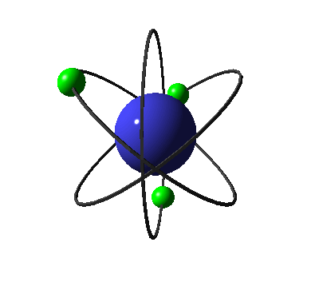
ATOMS & MOLECULES

Slide 2
Index
Introduction
Dalton's Theory And The Laws Of Chemical Combination
Atoms
Molecules and ions
Chemical formulae of compounds
Molecular mass & formula unit mass 7) The mole concept

Slide 3
1. Introduction
As early as the 6thcentury the Greek philosophers stated that all matter could be broken down into four basic substances: fire, air water and earth.

Slide 4
In the 5th century people pondered further on the nature of the primitive elements and thought the there must be things that are still smaller something which is common in every substance this made them think deeper and discover the presence of ultimate smallest particle the ‘ Atom’.

Slide 5
The atoms are so small that they are not visible by naked eyes. Fire, air, water and earth also have their individual atoms which are connected which each other.
After atoms a term for slightly bigger entities was coined that term is known as molecules.

Slide 6
2. Dalton's Theory And The
Laws Of Chemical Combination
At the end of the nineteenth century, scientists were able to differentiate between elements and
compounds. Antoine Laurent Lavoisier and Joseph
Louis Proust gave two laws, explaining the chemical combinations of elements. These laws are called
the Law of conservation of mass and the Law of constant proportion.

Slide 7
2.1 Law of conservation of mass
The law of conservation of mass states that the mass of a closed system will remain constant in a chemical reaction. In other words, mass can neither be created nor destroyed in a chemical reaction. This law was first formulated by Antoine Laurent Lavoisier in 1789.

Slide 8
2.2 Law of Constant Proportion
As we know, compounds are composed of two or more elements. The proportion in which elements are present in
a compound remains the same, irrespective of its method of preparation.
For example, pure water obtained from any source and from any country will always contain two hydrogen atoms and one oxygen atom. Hydrogen and oxygen respectively combine together in the ratio of 1: 8 by mass to form
water.

Slide 9
The ratio by the number of atoms for water will always be H : O = 2 : 1. Thus, 18 g of water contains 2 g of hydrogen and 16 g of oxygen.
Similarly, in ammonia, nitrogen makes up 14/ 17 of the mass of
ammonia while hydrogen makes up the remaining 3/ 17 of the mass.
Irrespective of the source from which ammonia is obtained, it will
always contain nitrogen and hydrogen in the ratio of 14: 3 by mass.
Thus, 17 g of ammonia contains 14 g of nitrogen and 3 g of hydrogen, and 34 g of ammonia contains 28 g of nitrogen and 6 g of hydrogen. This led to the law of constant proportion.

Slide 10
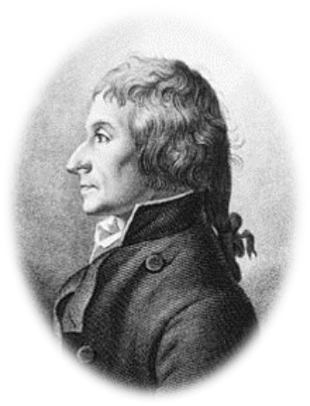

Thus, according to the law of constant proportion, a chemical substance always contains the same elements in a fixed proportion by mass, irrespective of its source.
The law of constant proportion is also known as the law of definite proportion. This law, which was introduced by Proust, stated that ‘in a compound, the elements are always present in definite proportions by mass’.

Slide 11
2.3 Laws of Chemical
Combination and Dalton’s Theory
The next challenge for the scientists was to come up with proper explanations for these laws. This was undertaken by a British chemist, John Dalton. He picked up the idea of divisibility of matter and said that ‘atoms are the smallest particles of matter, which cannot be divided further’. He provided a theory based upon the laws of chemical combinations and gave a successful explanation for the two laws.

Slide 12
The postulates of Dalton’ s atomic theory are as follows.
All matter is made up of very tiny particles. These particles are called atoms.
An atom cannot be divided further i. e., atoms are indivisible.
Atoms can neither be created nor destroyed in a chemical reaction.
All atoms of an element are identical in all respects, including the mass, chemical properties, etc.
Atoms of different elements have different masses and chemical properties.
Atoms of different elements combine in small whole number ratios to form compounds.
In a given compound, the relative number and types of atoms are constant.

Slide 13
2.4 Explanation of the Law of Chemical Combination using Dalton’s atomic theory:
The law of conservation of mass: Matter is made up of atoms (postulate 1), which can neither be created or destroyed (postulate 3). Hence, matter can neither be created nor destroyed. For example, 100 g of mercuric oxide, when heated in a closed test tube, decomposes to produce 92.6 g of mercury and 7.4 g of oxygen gas.

Slide 14
Total mass of the reactant = 100 g
Total mass of the products = 92.6 + 7.4 g = 100 g
Hence, during the decomposition reaction, matter is neither created nor destroyed. Here, matter is made up of tiny mercuric (Hg) and oxygen (O) atoms. The given reaction shows that atoms can neither be
created nor destroyed in chemical reactions.

Slide 15
The law of constant proportion: This law follows directly from the 6 ^{th} and 7th postulates of Dalton’s atomic theory, which state that atoms of different elements combine in small whole number ratios to form a compound; and in a g iven compound, the relative number and types of atoms are constant.
Now, we know that a sample of carbon dioxide ( no matter how it is prepared) is made up of carbon and oxygen. One carbon atom and two oxygen atoms combine to form a molecule of carbon dioxide. Thus, it obeys the law of constant proportion. The mass of carbon dioxide is 44 g . The mass of one oxygen and carbon atom is 16 u and 12 u respectively. Thus, in carbon dioxide, carbon and oxygen combine in the ratio of 3: 8 by mass.

Slide 16
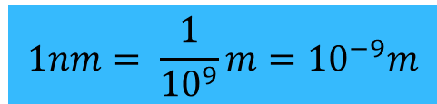
3. Atoms
The building blocks of an ant hill are small sand particles. Also, bricks are the building blocks of a building. Similarly, atoms are the building blocks of matter.
Atoms are indivisible particles that cannot be destroyed or created by any chemical
means. According to Dalton’ s atomic theory, all matter is made up of tiny particles called atoms. This would mean that a rod of iron is made up of millions of atoms of iron.
Size of an atom Atoms are very small in size. They are not visible even under a powerful optical microscope.
The size of an atom is indicated by the radius of the atom called the atomic radius. It is often expressed in nanometers so,

Slide 17
Hydrogen atom is the smallest of all atoms. The given table lists the atomic radius of some elements
Atom |  | Atomic radius in nm
Hydrogen |  | 0.037
Nitrogen |  | 0.074
Iron |  | 0.126

Slide 18
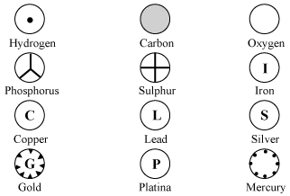
3.1 Representation of Atoms
Dalton was the first scientist to use symbols to represent different elements. Every symbol he proposed also represented a definite quantity of the respective element. The symbols of some common elements as proposed by
Dalton are shown in given figure.
∗

Slide 19
However, these symbols of el ements as proposed by Dalton were difficult to draw and remember. Therefore, an al ternative method of representing el ements was proposed J. J. Berzelius. He suggested that alphabets can be used as symbols to represent the e lements. Further, these symbols can be made from one or two le tters of the name of the e lement.
The modern symbols of el ements make use of this idea. IUPAC (International Union of Pure and Applied Chemistry) approves the names of the el ements. Also, it approves the symbol of the e lement made from one or two le tters of the English or Latin name of that e lement. As a rule, the first le tter of a symbol is always written as a capital le tter and the second le tter as small l etter.

Slide 20
3.2 The modern symbols of some common elements are given in the following table
Element
 | Symbol | Element | Symbol
Aluminium | Al | Iron | Fe
Argon | Ar | Lead | Pb
Calcium | Ca | Magnesium | Mg
Carbon | C | Nitrogen | N
Chlorine | Cl | Oxygen | O
Copper | Cu | Potassium | K
Fluorine | F | Silicon | Si
Gold | Au | Silver | Ag
Hydrogen | H | Sodium | Na

Slide 21
3.3 Atomic mass
Mass is a characteristic property of matter. Hence, the atoms present in matter also possess mass. The mass of an atom is known as the atomic mass.
Atoms of a given element are identical in shape, size, mass, chemical properties etc. Atoms of different elements have different masses and chemical properties.

Slide 22
3.4 Determination of the
atomic mass
It is difficult to determine the mass of an individual atom. However, relative atomic mass can be determined by comparing the mass of a particular atom with that of an atom of standard reference. The
unit of the mass of an atom is atomic mass unit
(amu). Initially, John Dalton suggested that the mass of a hydrogen atom be taken as a standard reference of atomic mass unit

Slide 23
The atomic mass of some common elements is given in the following table
 | Element | Atomic mass | Element | Atomic mass
 | Hydrogen | 1u | Potassium | 39u
 | Helium | 4u | Calcium | 40u
 | Carbon | 12u | Argon | 40u
 | Nitrogen | 14u | Iron | 36u
 | Oxygen | 16u | Copper | 63. 5u
 | Fluorine | 19u | Zinc | 65u
 | Neon | 20u | Bromine | 180u

Slide 24
4 . Molecules And Ions
The smallest particle of a substance is called an atom. An atom is very small in size and it cannot be divided further. Although atoms are the smallest particles of a substance, atoms of most elements are not stable and cannot exist independently. Therefore, two or more atoms of the same or different elements combine to form a stable entity called molecules. Hence, a molecule can be defined as the smallest entity of a substance, capable of independent existence.

Slide 25
The constituting atoms of a molecule are held together by a strong attractive force. For example, (H₂) is a molecule in which two hydrogen atoms are chemically bonded. Similarly, hydrogen atoms can also combine with oxygen atoms to form water molecules.
A molecule is the smallest particle of an element or a compound
that can exist independently and possess all the properties of the substance to which it belongs.

Slide 26
4.1 Molecules of
elements
The molecules of an element are composed of identical atoms. For example, an oxygen molecule (O₂) consists of two oxygen atoms and a nitrogen molecule (N₂)
consists of two nitrogen atoms. N₂ and O₂ are called diatomic molecules . Thus, the atomicity of nitrogen and oxygen is two. When three atoms of oxygen combine, a molecule of ozone (O₃) is formed. Here, the atomicity of oxygen is three. The number of atoms constituting a molecule is known as its atomicity.

Slide 27
4.2 Molecules of compounds
The molecules of a compound are formed when atoms of different elements combine chemically in definite proportions. For example, the molecules of carbon dioxide (CO₂) consist of one carbon (C) atom and two oxygen (O) atoms. Therefore, the ratio by number of atoms present in the molecule of carbon dioxide is C:O= 1:2. This means that the ratio by mass of atoms present in the molecule of carbon dioxide (C: O) is 3:8 (12 × 1: 16 × 2 = 12:32, where 12 u and 16 u are the atomic masses of carbon and oxygen atoms respectively).

Slide 28
4.3 Structures of some Molecule

Slide 29
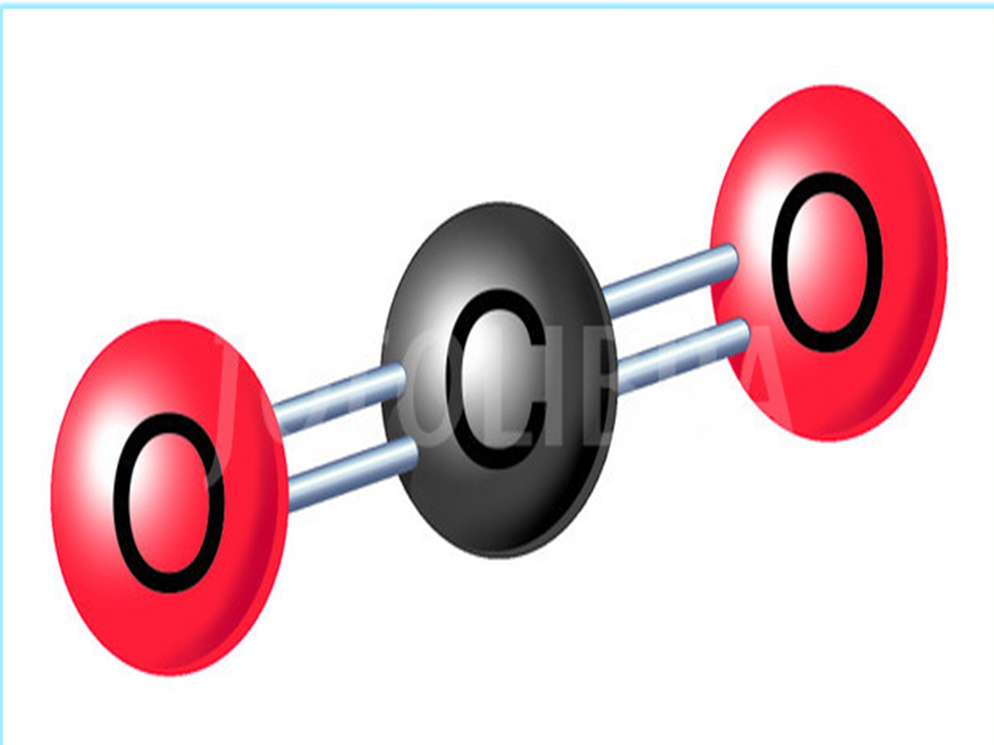
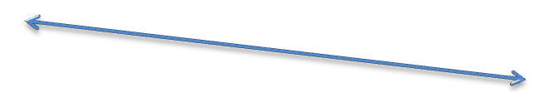




This model represents the linear
structure of carbon dioxide(co2) molecule
Double bonds
Carbon atom
Oxygen atoms

Slide 30
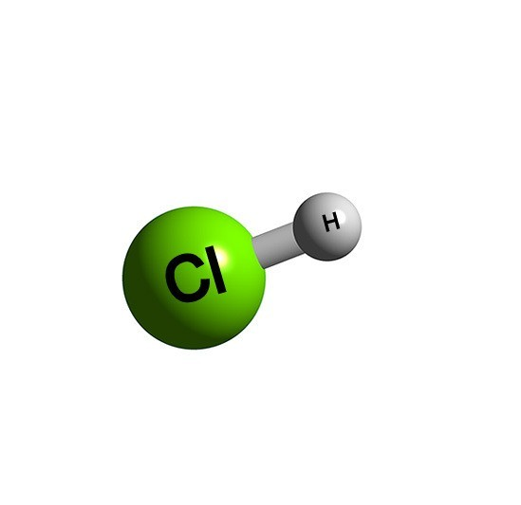



Hydrochloric acid(Hcl) molecule
Hydrogen atom
Single covalent bond (sharing 2 electrons;1 from chlorine the other from hydrogen)
Chlorine atom

Slide 31
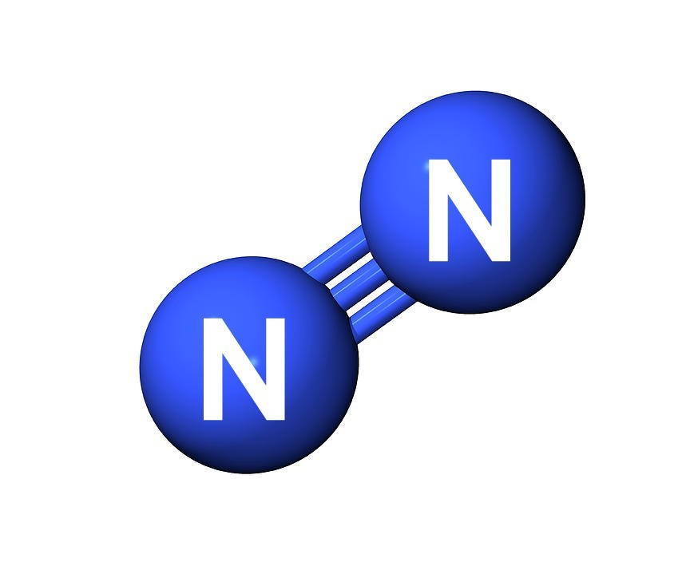
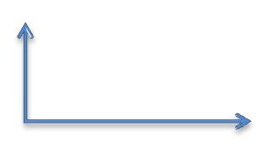

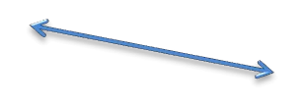
Nitrogen(N) molecule
Triple bonds
This triple bond makes N2 inert
Nitrogen atoms

Slide 32
4.4 Ions
An ion is a charged species in which an atom or a group of atoms possess a net electric charge. The net electric charge of an ion can either be positive or negative. Positively charged ions are called cations and negatively charged ions are called anions.

Slide 33
Molecules that are composed of metals and non-metals contain charged species. For example, potassium chloride (KCl) consists of K⁺ ion (cation) and Cl– ion (anion). Similar to molecules, an ion can be monoatomic, diatomic, tetra-atomic, etc. Ions may consist of a single charged atom or a group of atoms that have a net charge over them. A group of atoms carrying a charge are known as polyatomic ions .

Slide 34
Cation | Symbol | Atomicity | Anion | Symbol | Atomicity
Aluminiu m | _{Al}3+ | Monoato mic | Bromide | Br– | Monoatom ic
Calcium | _{Ca}2+ | Monoato mic | Chloride | Cl– | Monoatom ic
Cuprous ion | Cu⁺ | Monoato mic | Fluoride | _{F}– | Monoatom ic
Cupric ion | _{Cu}2+ | Monoato mic | Hydride | _{H}– | Monoatom ic

Slide 35
4.4 Ionic compounds
Compounds in which molecules are formed by the combination of cations (positively charged ions) and anions (negatively charged ions) are known as ionic compounds . For example, zinc oxide (ZnO). This is formed by the combination of zinc ion (Zn²⁺) and oxide ion (O^{2–}). Other examples of ionic compounds are magnesium chloride (MgCl₂), potassium bromide (KBr), sodium chloride (NaCl), etc.

Slide 36
The table given below illustrates some examples of ionic compounds.
Ionic Compound | Combining Elements | Ratio by mass | Ratio by number of ions
Calcium oxide | Calcium, oxygen | 5:2 | 1:1
Magnesium chloride | Magnesium, chlorine | 24:71 | 1:2
Aluminium | Aluminium, | 27:32 | 2:3

Slide 37
5. Writing Chemical
Formulae Of Compounds
Chemical formula of a compound is the symbolic representation of its atomic constituents. In other words, a chemical formula represents the composition of a molecule in terms of the symbols of the elements present in that molecule. To write the chemical formula of a compound, one should have prior knowledge of two things:
The symbols of the constituent elements, and
The combining capacity of each atom constituting the compound

Slide 38
We know that the combining power or the combining capacity of an atom or an element is called its valency . The number of atoms of other elements with which one atom of an element combines is decided by the valency of that element
For example, both hydrogen and chlorine have a valency of 1. Therefore, one atom of hydrogen reacts with one atom of chlorine to form one molecule of hydrogen chloride.
The valency of an ion is equal to the charge on it.

Slide 39

Name of ion | Symbol | Valency | Name of | Symbol | Valency
 |  |  | ion
Aluminium | _{Al}3+ | 3 | Sulphite |  | 2
Ammoniu m |  | 1 | Bromide | Br⁻ | 1
Calcium | _{Ca}2+ | 2 | Carbonate |  | 2
Copper(II) | _{Cu}2+ | 2 | Chloride | Cl⁻ | 1
Hydrogen | _{H}+ | 1 | Hydride | _{H}−
Iron(II) | _{Fe}2+ | 2 | Hydrogen |  | 1

Slide 40
While writing the chemical formula, certain rules need to be kept in mind. These rules are given below:
The valencies or charges on the ions must be balanced.
In case of a compound consisting of a metal and a non-metal, the symbol of the metal is written first. For example, in calcium chloride (CaCl ₂) and zinc sulphide (ZnS), calcium and zinc are metals, so they are
written first, whereas chlorine and sulphur are non-metals.
(iii) In case of compounds consisting of polyatomic ions, the polyatomic ions are enclosed in a bracket before writing the number to indicate the ratio. For example, in aluminium sulphate [Al ₂ (SO ₄)₃], the polyatomic sulphate ion is enclosed in a bracket before writing

Slide 41
Compounds composed of two different elements are called binary compounds. These are the simplest compounds. While writing the chemical formulae for compounds, we first write the constituent elements and their valencies and then crossover the valencies of the combining atoms.

Slide 42

For example
Formula of calcium oxide
Symbol Ca O
Charge 2+ 2−
Thus, the chemical formula of calcium oxide is CaO..

Slide 43
6. Molecular Mass and
Formula Unit Mass
An atom contains three types of particles i.e. electrons, protons , and neutrons . Out of these three particles, the mass of electrons is negligible as compared to that of protons and neutrons. Thus, the mass of an atom is equal to the mass of the total number of neutrons and protons present in it.
Molecules are formed when two or more atoms combine chemically in a fixed proportion.The molecular mass of a substance is the sum of the atomic masses of all the atoms present in a molecule of that substance. This is also called the relative molecular mass and its unit is atomic mass unit (u). Hence, to calculate the mass of molecules i.e. to calculate the molecular mass, the mass of all the atoms present in it are added .

Slide 44
6.1 Calculation of molecular mass:
Molecular mass of sodium hydroxide and potassium sulphate. 1) The chemical formula of sodium hydroxide is NaOH
Atomic mass of Sodium (Na) = 23 u Atomic mass of Oxygen (O) = 16 u Atomic mass of Hydrogen (H) = 1 u
Since sodium hydroxide molecule contains one atom of sodium, one atom of oxygen, and one atom of hydrogen.
Thus, the molecular mass of NaOH = 23 + 16 + 1
= 40 u

Slide 45
2) The chemical formula of potassium sulphate is K ₂SO₄
Atomic mass of Potassium (K) = 39 u Atomic mass of Sulphur (S) = 32 u Atomic mass of Oxygen (O) = 16 u
Since potassium sulphate molecule contains two atoms of potassium, one atom of sulphur, and four atoms of oxygen.
The molecular mass of K ₂SO₄ = 39 × 2 + 32× 1 + 16 × 4
= 78 + 32 + 64
= 174 u

Slide 46
6.2 Formula unit and formula unit
mass
The term formula unit is used for those substances whose constituent particles are ions. The formula unit mass of a substance is the sum of the atomic masses of all the atoms in the formula unit of a compound.
For example, calcium oxide has a formula unit CaO.

Slide 47
Calculation of formula unit mass
Formula unit mass is calculated in the same way as molecular mass.
formula unit mass of nitric acid and sodium oxide.
1) The chemical formula of nitric acid is HNO₃ Atomic mass of Hydrogen
(H) = 1 u Atomic mass of Nitrogen (N) = 14 u Atomic mass of Oxygen (O) = 16 u
In one formula unit of HNO₃, there are one hydrogen (H) atom, one nitrogen (N) atom, and three oxygen (O) atoms.
Thus, the formula unit mass of HNO₃ = 1 × 1 + 14 × 1 + 16× 3
= 1 + 14 + 48
= 63 u

Slide 48
2) The chemical formula of sodium oxide is Na ₂O Atomic mass of sodium (Na) = 23 u
Atomic mass of oxygen (O) = 16 u
In one formula unit of Na ₂O, there are two sodium (Na) atoms and an oxygen (O) atom.
Thus, the formula unit mass = 2 × 23 + 1 × 16
= 46 + 16
= 62 u

Slide 49
7. The Mole Concept
One mole of a substance (atoms, molecules, ions, or particles) is that quantity in number having a mass equal to its atomic or
molecular mass in grams. One mole of any substance contains 6.022
× 10²³ particles (atoms, molecules, or ions). This means that one mole atom
of any substance contains 6.022 ×10²³ atoms. Similarly, one mole molecule of any substance contains 6.022 ×10²³ molecules, and one mole ion of any substance contains
6.022 ×10²³ ions. Hence, the mass of a particular substance is fixed.
The number 6.022 × 1023 is an experimentally obtained value and is known as Avogadro’s number or Avogadro constant (represented by No). It is named after the Italian scientist, Amedeo Avogadro

Slide 50
1 mole atoms of an element has a mass equal to the gram atomic mass of that element. Hence, the mass of 1 mole molecules is equal to its molecular mass in grams. The atomic mass of an element is the mass of its atom in atomic mass units (u). By taking the same numerical value of atomic mass and changing the units from ‘u’ to ‘g’, the mass of 1 mole atoms of that element is obtained. The mass of one mole of atoms is known as the molar mass of atoms, gram atomic mass, or gram atoms. For example, the atomic mass of nitrogen is 14 u, and the gram atomic mass of nitrogen is 14 g. Similarly, the molecular mass of a
substance gives the mass of a molecule of that substance in atomic mass units (u). Therefore, as discussed earlier, by taking the same numerical value of molecular mass and by changing its units from ‘u’ to ‘g’, the mass of one mole molecules of that substance can be obtained.
Therefore, the mass of one mole molecules of any substance is equal to the gram molecular mass of that substance.

Slide 51
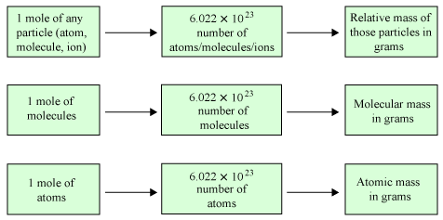
The relationship between the mole,
Avogadro’s number, and mass is summarized as follows:
∗

